Slide 1
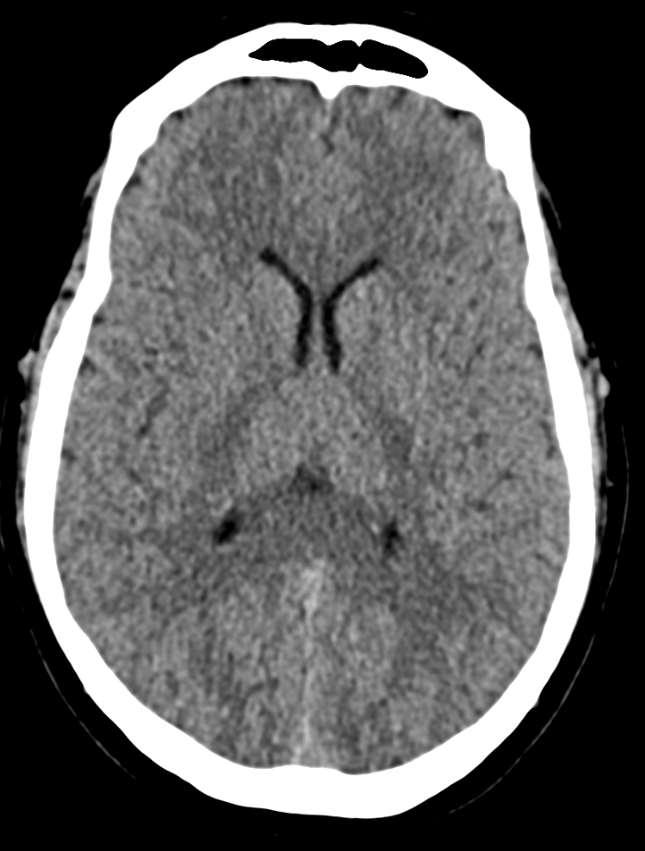
IMAGE RECONSTRUCTION for CT/MRI
USING GAUSS ELIMINATION
METHOD
NEEL AMRISH PATEL

Slide 2
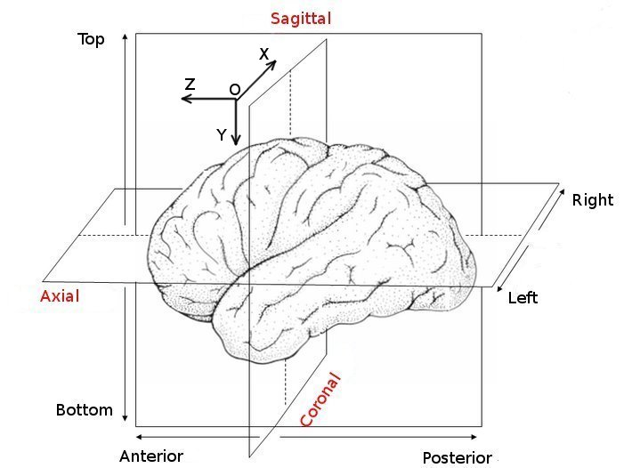
Why Do We Need Image Reconstruction?
CT/MRI scanners collect projections, not direct
images.
Projections = sum of pixel intensities along rays.
Example: Beams passing through body → detectors measure
absorption.
Types of projections used:
Horizontal
Vertical
Diagonal
Bottom Row
Visual: CT slice with rays from 4 directions
(H, V, D, B).

Slide 3
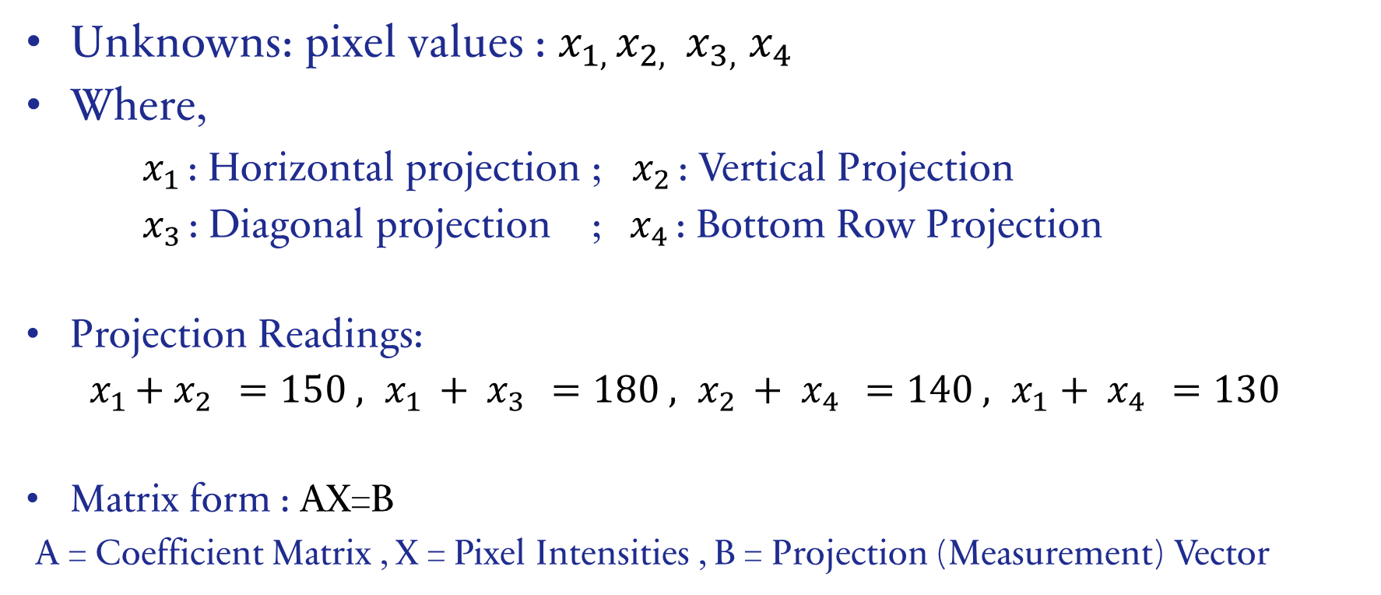
Turning Projections into Linear Equations
Unknowns: pixel values : $x_{1, }x_{2, }$ $x_{3,}$ $x_{4}$
Where,
$x_{1 }$: Horizontal projection ; $x_{2 }$: Vertical Projection
$x_{3 }$: Diagonal projection ; ${ x}_{4 }$: Bottom Row Projection
Projection Readings:
${ x}_{1 }+ x_{2 }=150 , x_{1 }+ x_{3 }=180 , x_{2 }+ x_{4 }=140 , x_{1}+ x_{4 }=130$
Matrix form : AX=B
A = Coefficient Matrix , X = Pixel Intensities , B = Projection (Measurement) Vector

Slide 4
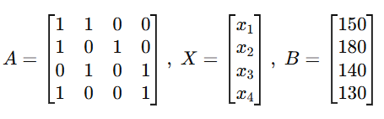
Linear Equations in Imaging
Each ray is represented by a Linear Equation.
Whereas all rays together are represented by System of equations.
Image reconstruction = Solving for unknown pixel intensities.

Slide 5
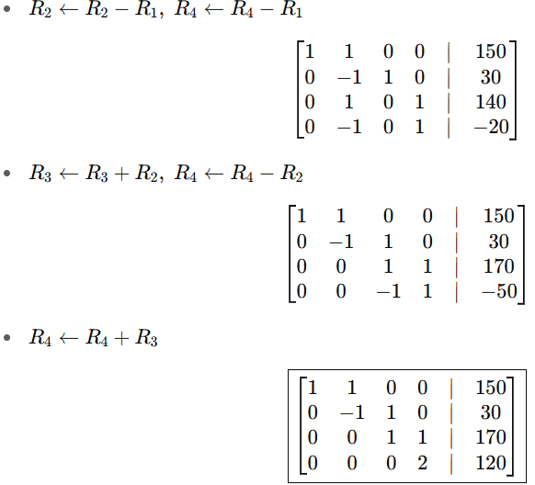
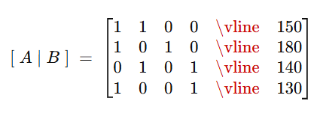

Using Gauss Elimination
Step 1: Convert equations → triangular form.
Step 2: Apply back-substitution to solve unknowns.
Example solution: Pixel intensities recovered.

Slide 6
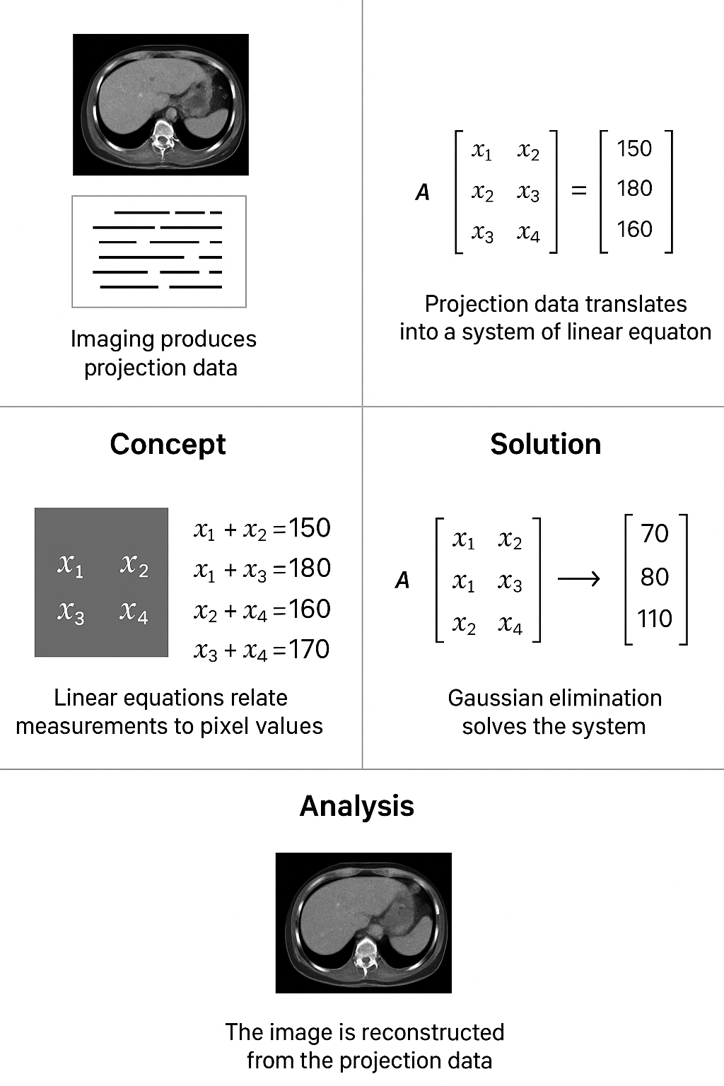
AnALYSIS

Slide 7
THANK YOU
NEEL PATEL
25MAI011@sot.pdpu.ac.in

